Slide 1
Badminton Association of Zimbabwe Annual General Meeting 2021

Slide 2
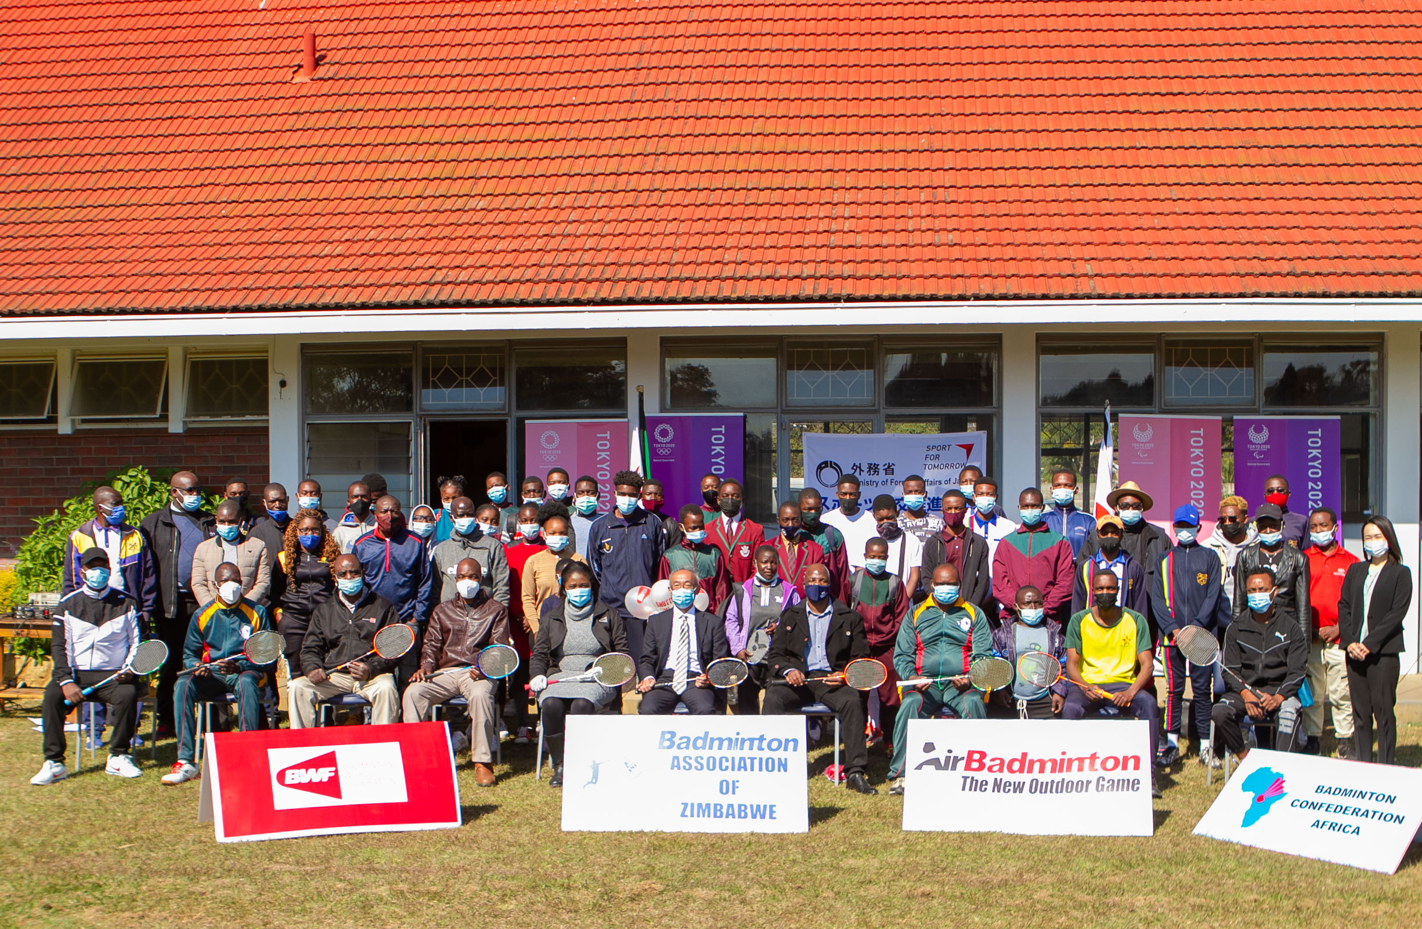

Slide 3
2021 in retrospect

Slide 4
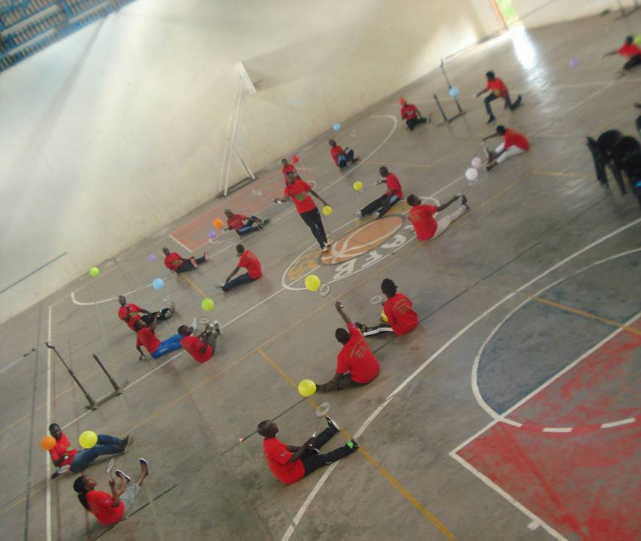
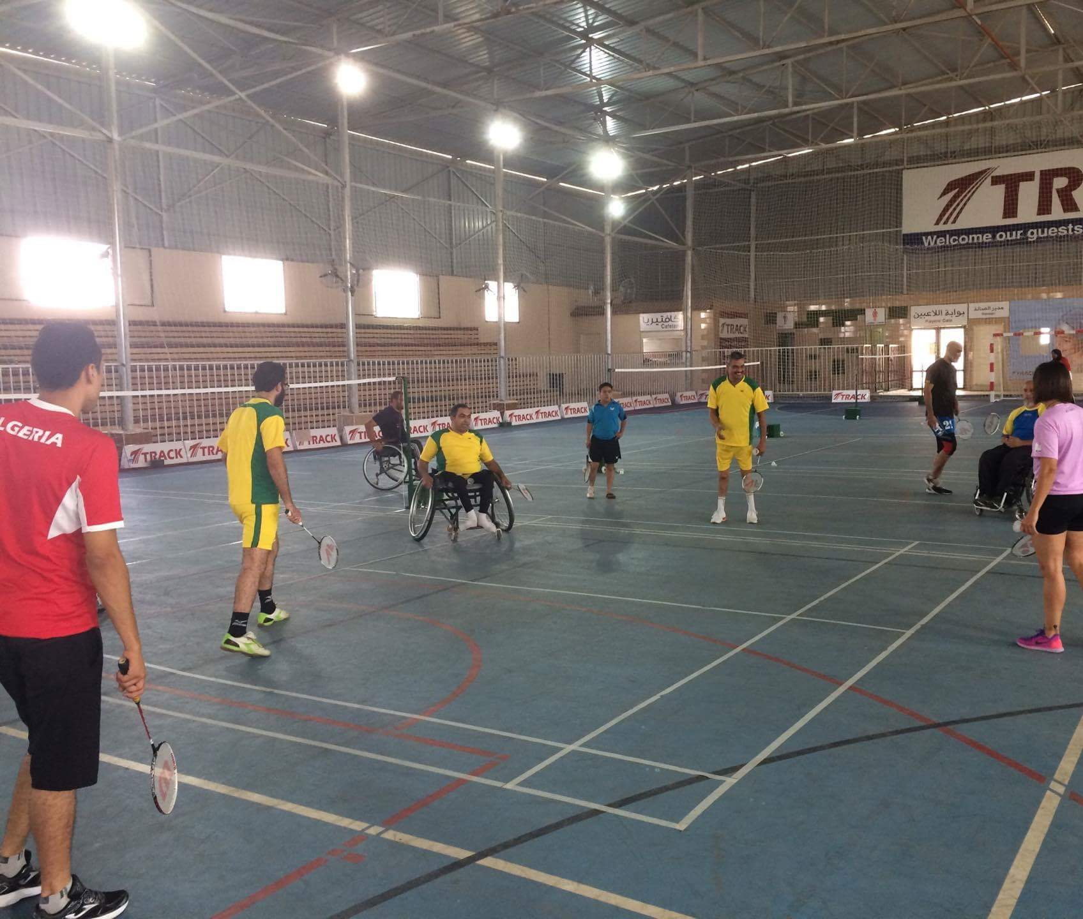
Notes:
Links:
https://www.pexels.com/photo/photo-of-people-doing-handshakes-3183197/
https://www.pexels.com/photo/photo-of-people-holding-each-other-s-hands-3184436/

Slide 5
Badminton
Para badminton debuted at the Tokyo Paralympics
AirBadminton (outdoor Badminton) launched in 2020 and can now be played competitively on sand

Slide 6
Administration

Slide 7
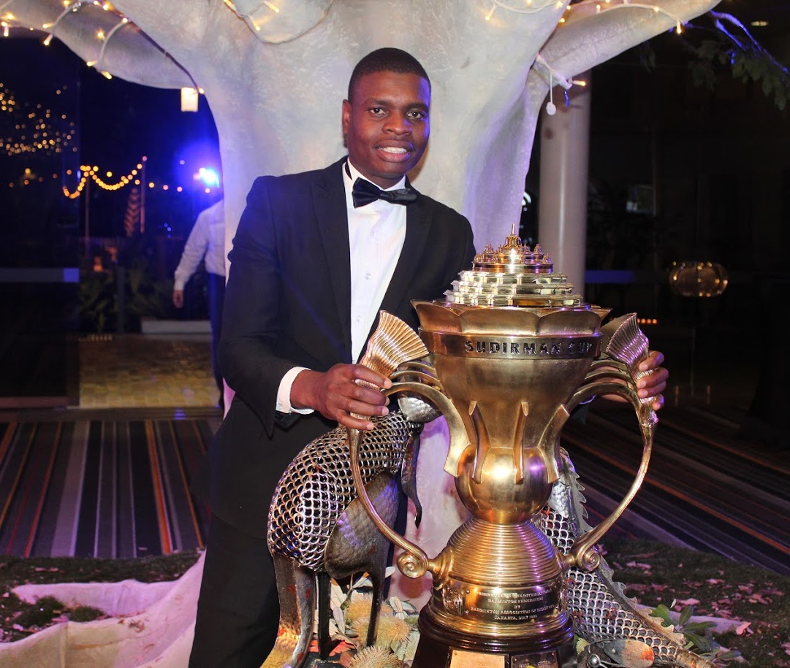
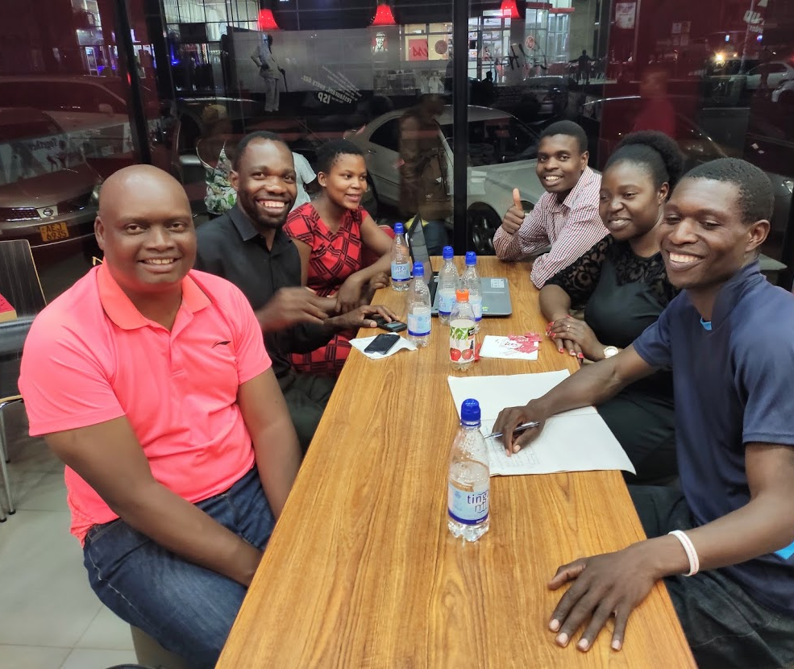
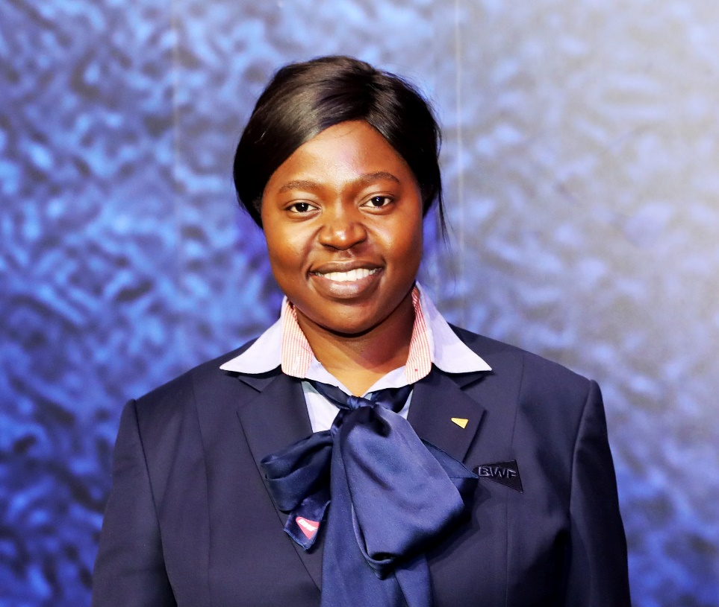
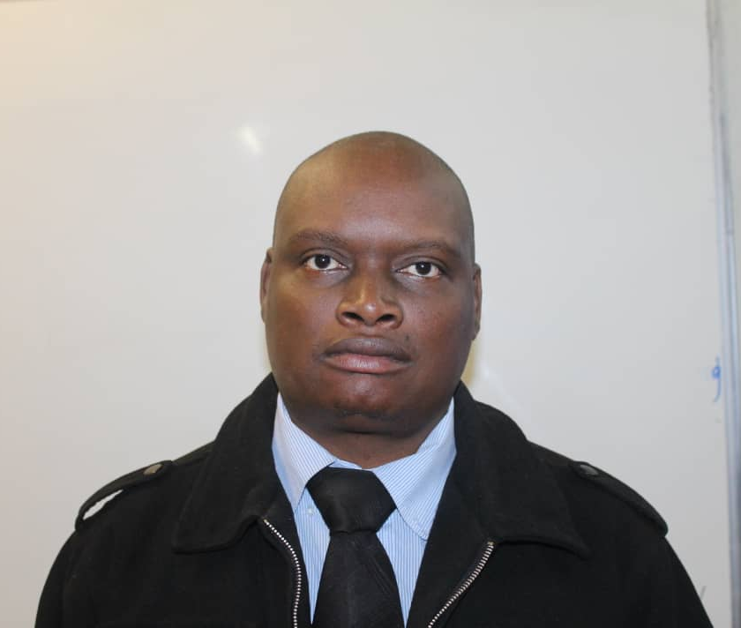
Notes:
Links:
https://www.pexels.com/photo/photo-of-people-doing-handshakes-3183197/
https://www.pexels.com/photo/photo-of-people-holding-each-other-s-hands-3184436/

Slide 8
Successes
We have been able to achieve a lot with a few active members
Participation
Exponential growth of our sport in the past couple of years
Success with grassroots development programmes
Growing numbers of players and fans in all parts of the country
Registered with Sports and Recreation commission and affiliated with Zimbabwe Olympic Committee (ZOC) and Zimbabwe Paralympic Committee (ZNPC)
Good representation in institutional sport (ZOC, BCA, BWF etc)

Slide 9
Challenges
Fewer volunteers than is desirable
Limited sponsorship
Lack of investment into our sport in our country
Lack of or constrained resources means fewer
opportunities for our athletes
Governance challenges (no quorum, inactive board members)
Clubs and other structures
COVID-19 pandemic

Slide 10
Our mission and vision
Badminton Association of Zimbabwe believes in inclusion and has given itself the mission to grow, foster and promote badminton at all levels with a quest to create opportunities for recreation and competition for all Zimbabweans
This is consistent with our vision of become one of the leading Badminton playing countries in Africa and beyond by 2030
We have also adopted our World Federation’s mission into all our development programmes which is ‘to give every child a chance to play for life’

Slide 11
Our values
Our values include
- Progressive development of the game
- Accountability
- Relationship building
-Respect
- Innovation
- Inclusion
- Teamwork
- Commitment

Slide 12
What do we do?
On average – 40 activities in a year (more than once a week) around the country
Activities include:
Grassroots development programmes for Shuttle Time, Airbadminton
Local tournaments & participation in continental events
Training Camps for Players
Training Programmes for Coaches, Technical Officials, Administrators, Events Organizers, School Teachers, Media, Women in Badminton, etc

Slide 13
Our championships
5 Main African Championships
Senior (Yearly Event)
Under 19 (Once every 2 years – even years)
Under 15 (Once every 2 years – odd years)
School (Yearly Event)
Para Badminton (Once every 2 years – even years)
The qualifiers out of the above events also get to participate in the same on the African continent in each applicable year
In 2022, we wish to resume hosting the Zimbabwe International which is sanctioned by BWF. Our athletes also participate in the same internationally

Slide 14
Para badminton

Slide 15
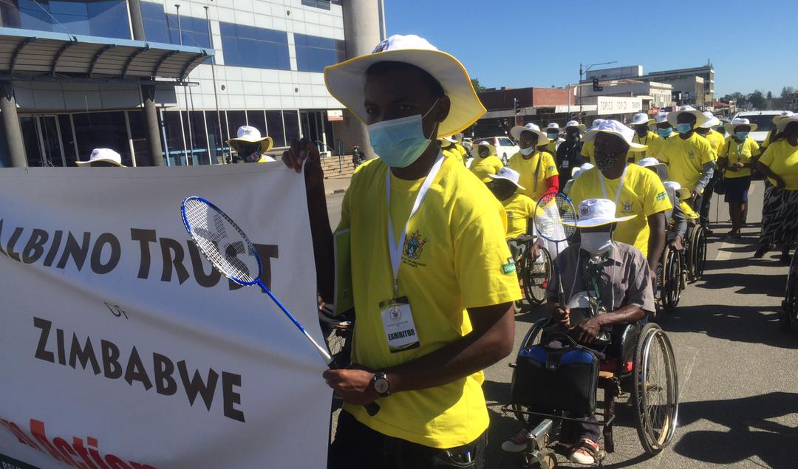
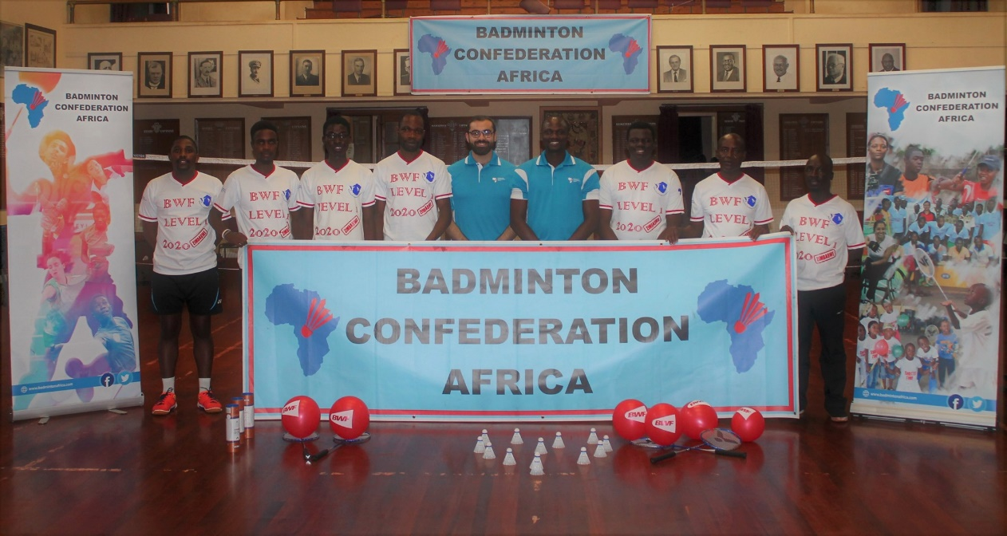
Notes:
Links:
https://www.pexels.com/photo/photo-of-people-doing-handshakes-3183197/
https://www.pexels.com/photo/photo-of-people-holding-each-other-s-hands-3184436/

Slide 16
Para badminton
We are partnering with organizations for persons living with disability
Leonard Cheshire Shuttle Time
We exhibited at the disability expo in Gweru
We received the female participation grant that allowed our athletes to go to
Uganda

Slide 17
Our athletes

Slide 18
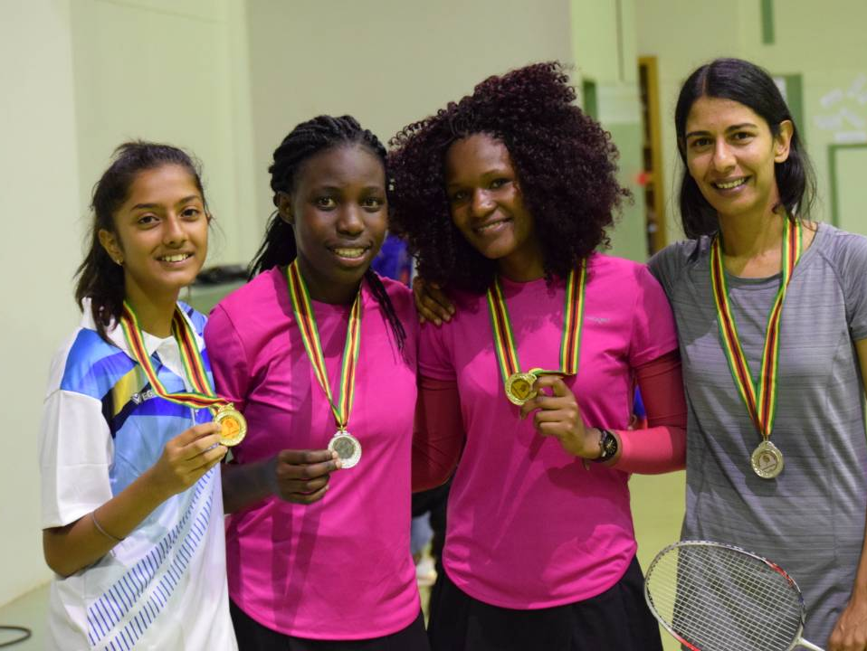
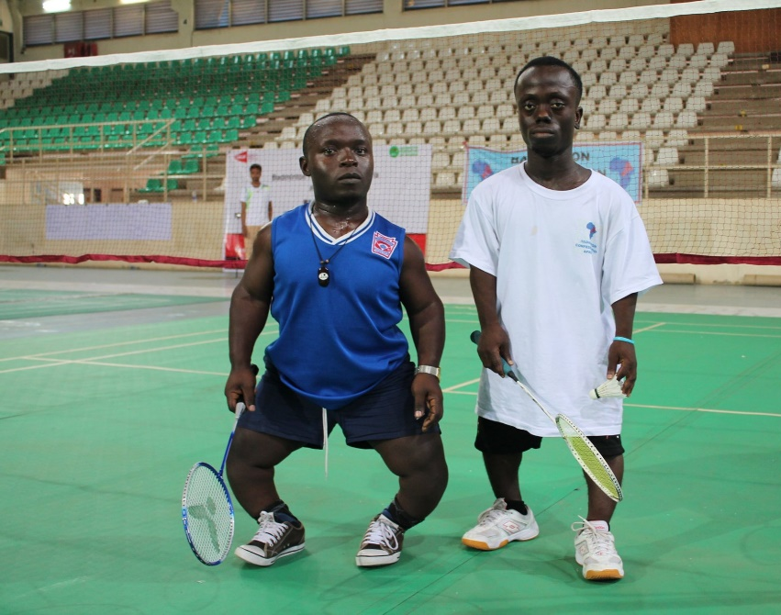
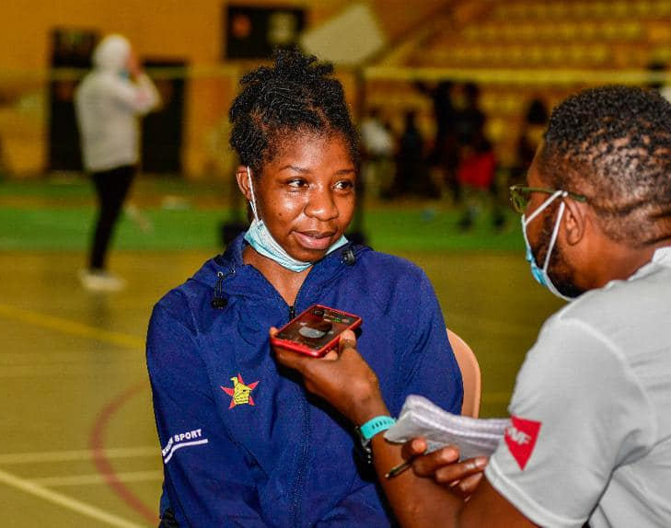
Notes:
Links:
https://www.pexels.com/photo/photo-of-people-doing-handshakes-3183197/
https://www.pexels.com/photo/photo-of-people-holding-each-other-s-hands-3184436/

Slide 19
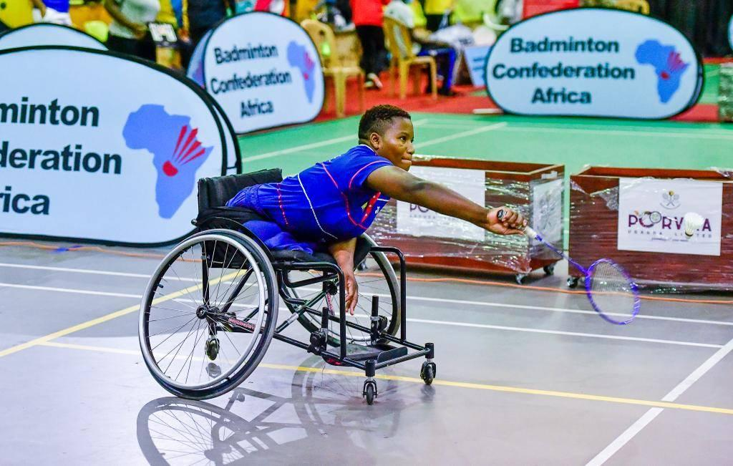
Our top ranked athletes
Stellah Jongwe
Zim Wheelchair 1
Para badminton No 1
World ranking No. 23
Thabani Mathe
Zim Men’s singles No 1
World ranking No. 992
Dean Matyanga
Zim Men’s singles No 2
World ranking No. 1030

Slide 20
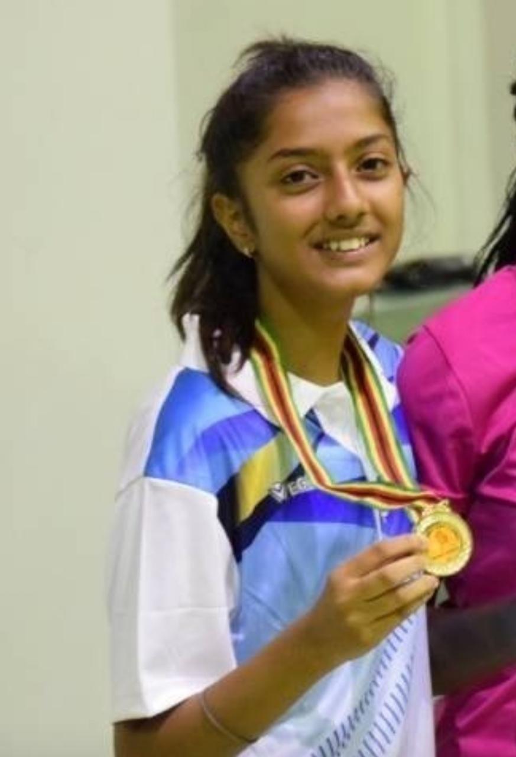
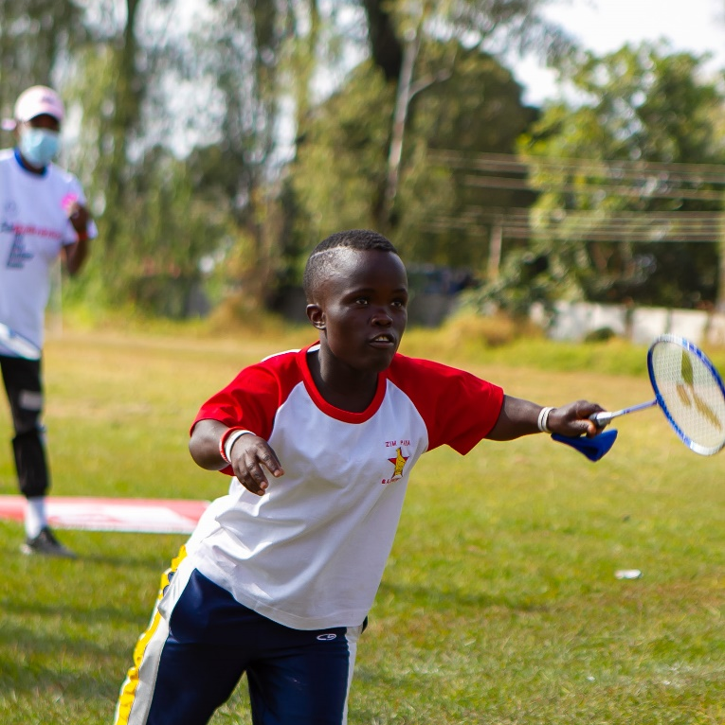
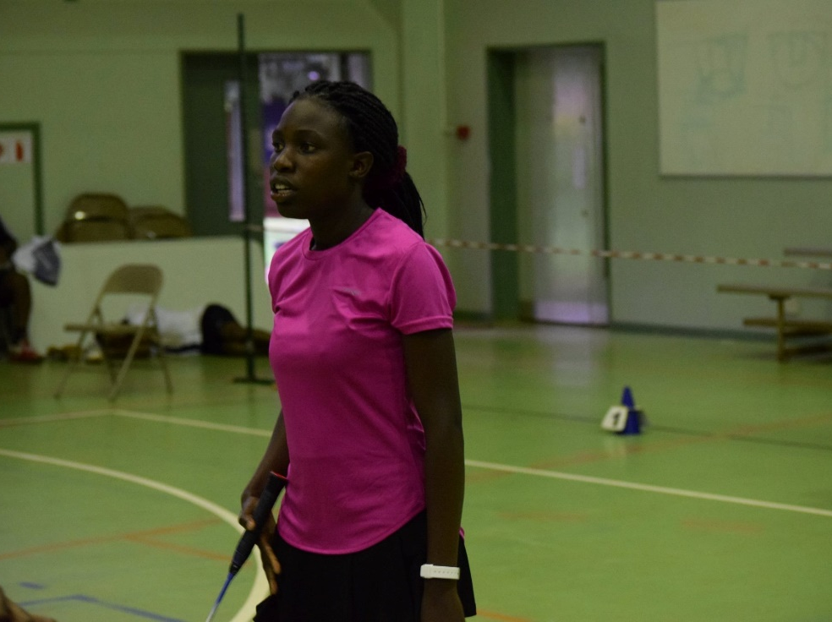
Our top ranked athletes (continued)
c
Moline Mavhunga
Zim Short Height
Para badminton No 2
Highest World Ranking No.11
Avishi Raina
Zim Women’s singles No 1
World ranking No. 668
Nyasha Kopolo
Zim Women’s singles No.2
World ranking No. 963

Slide 21
Athletes
WAoS Scholarships
Player development programmes – this year Avishi and Thabani went to
Botswana
Participation
Athletes’ representation
Impact of COVID-19

Slide 22
Development

Slide 23
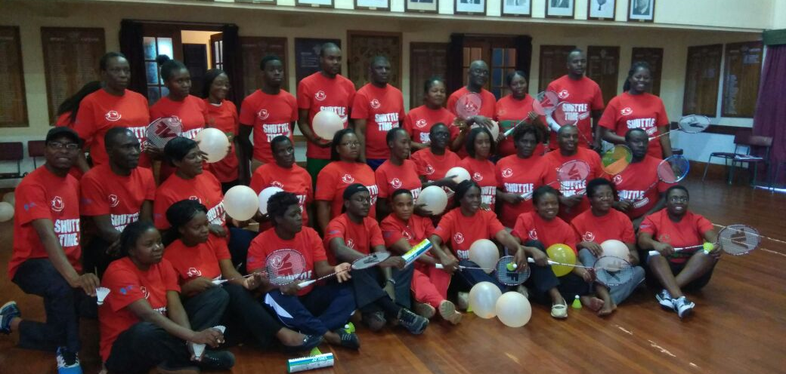
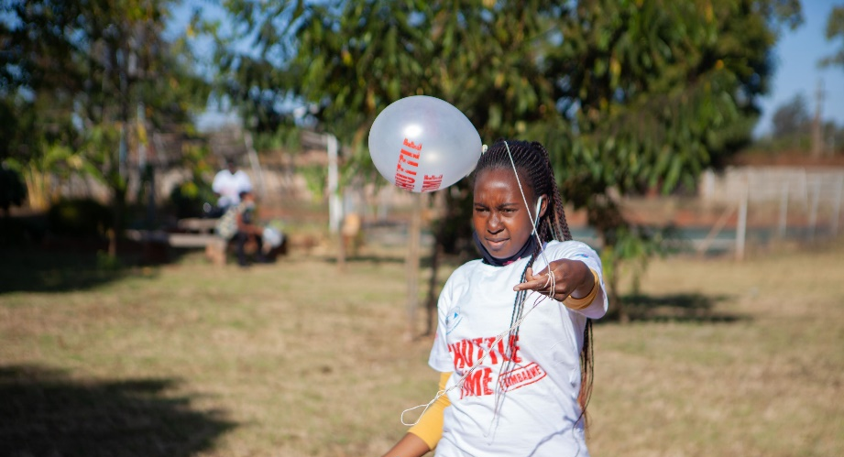
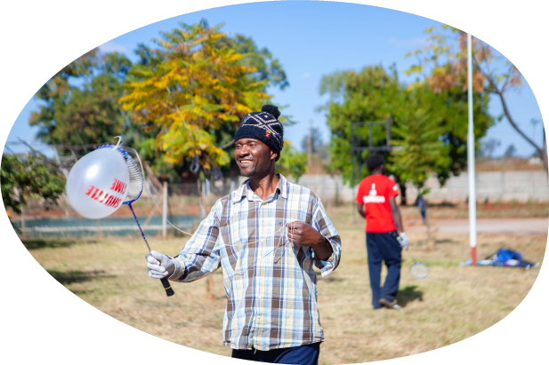
Notes:
Links:
https://www.pexels.com/photo/photo-of-people-doing-handshakes-3183197/
https://www.pexels.com/photo/photo-of-people-holding-each-other-s-hands-3184436/

Slide 24
Our programmes
“Shuttle Time” (School Programme) activated in four provinces of Zimbabwe
Has seen the training of over 200 teachers and tutors in these provinces
In collaboration with Sports & Recreation Commission and Zimbabwe Olympic Committee and supported by Badminton World Federation and Badminton Confederation Africa
Courses for Coaches, Technical Officials, Administrators and other stakeholders are regularly organized.
Camp for best players
AirBadminton (Outdoor Badminton) was launched in 2021– AirBadminton provides a unique opportunity in this pandemic and in areas where there are no badminton facilities

Slide 25
2021 Programmes
Return to Badminton event
Equipment handover ceremory with the Japanese Ambassador
A number of Shuttle Time courses
AirBadminton (Outdoor Badminton) was launched in 2021– AirBadminton provides a unique opportunity in this pandemic and in areas where there are no badminton facilities

Slide 26
Communication and
media

Slide 27
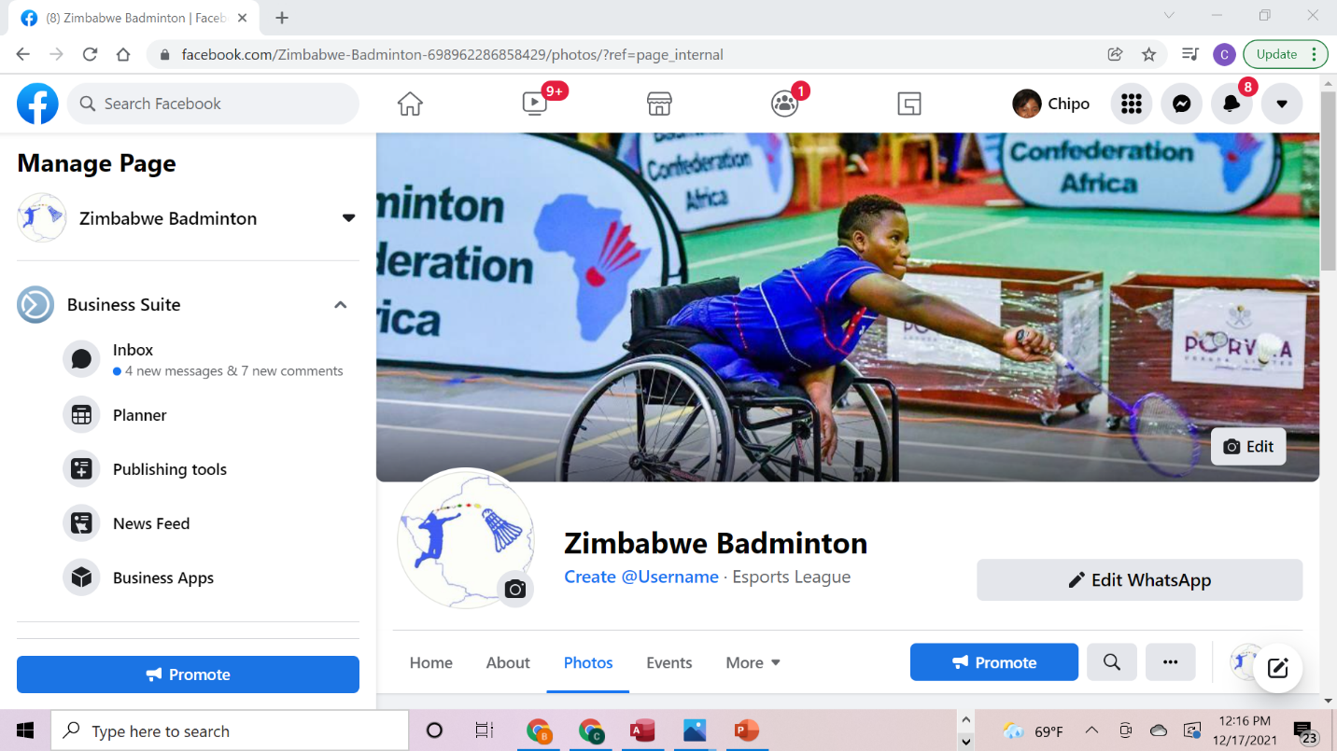
Notes:
Links:
https://www.pexels.com/photo/photo-of-people-doing-handshakes-3183197/
https://www.pexels.com/photo/photo-of-people-holding-each-other-s-hands-3184436/

Slide 28
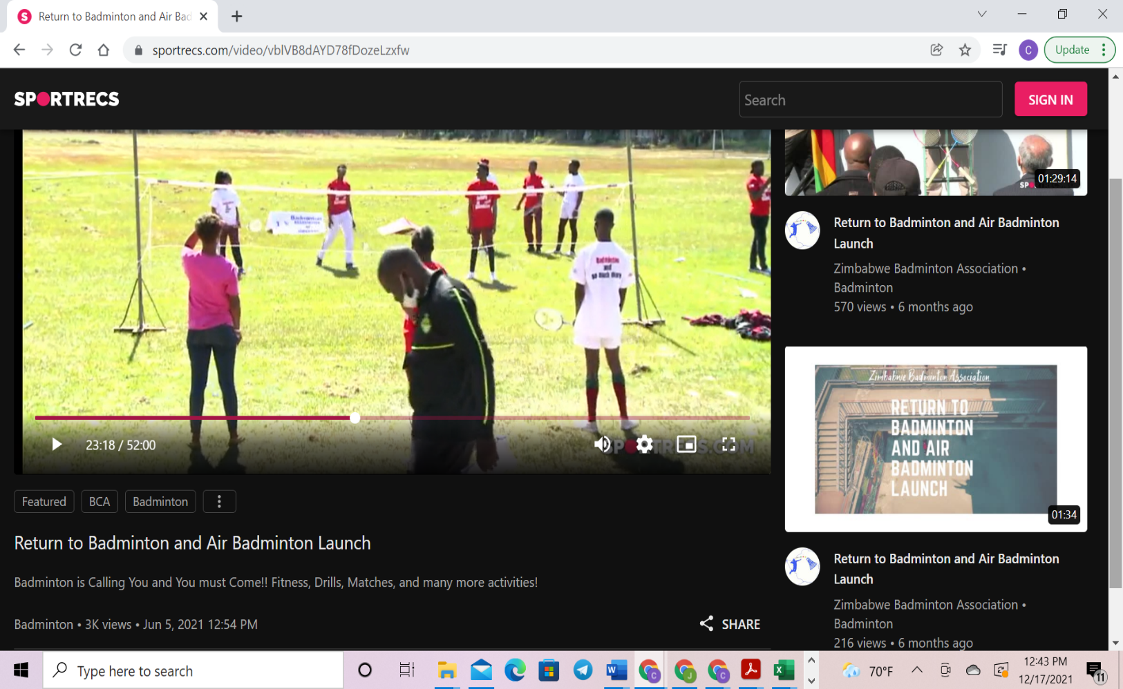
Live Streaming
Earlier in the year we had a lot of success with livestreaming our events. Our colleagues followed the events from different parts of the country and the world.
Although many of our events were cancelled due to the COVID- 19 pandemic, we are excited about this initiative going into 2022.

Slide 29
Sponsorship

Slide 30
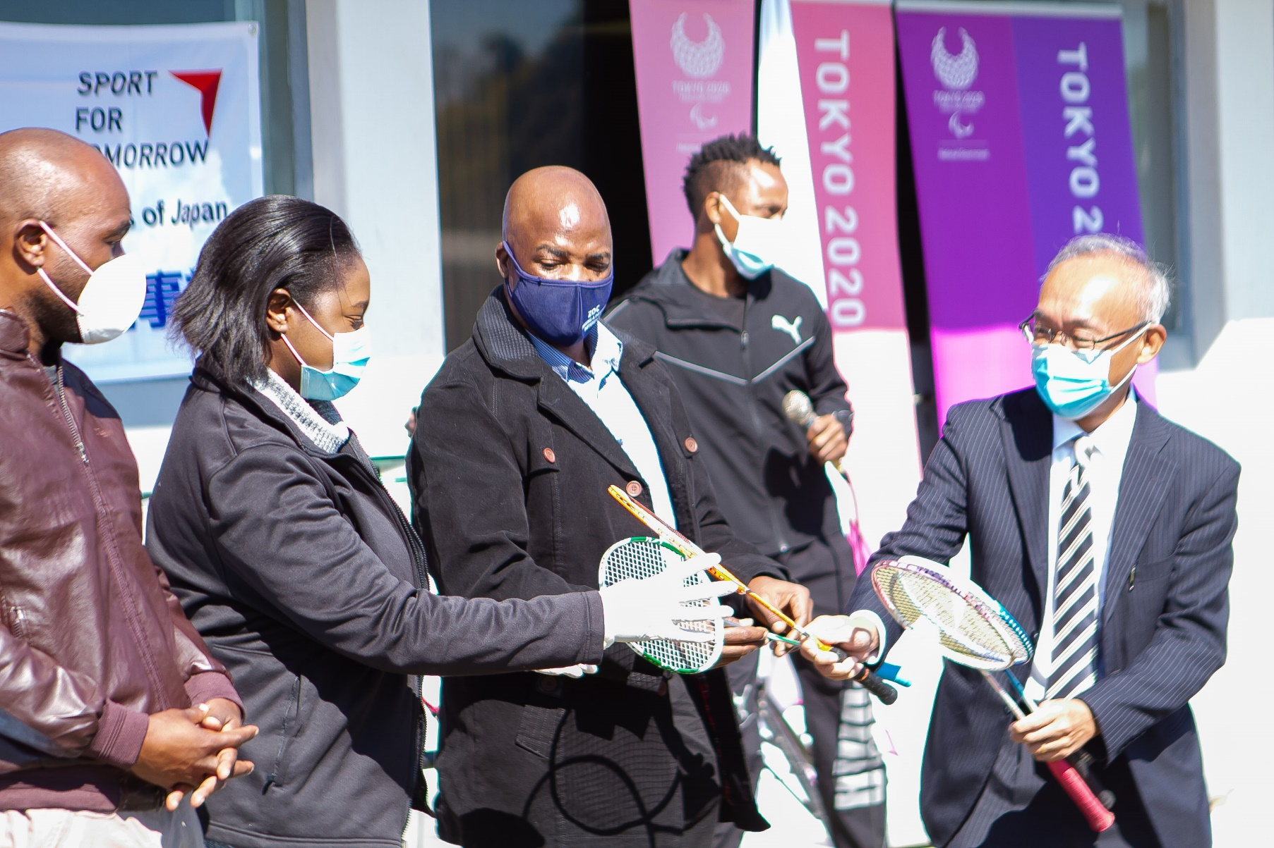
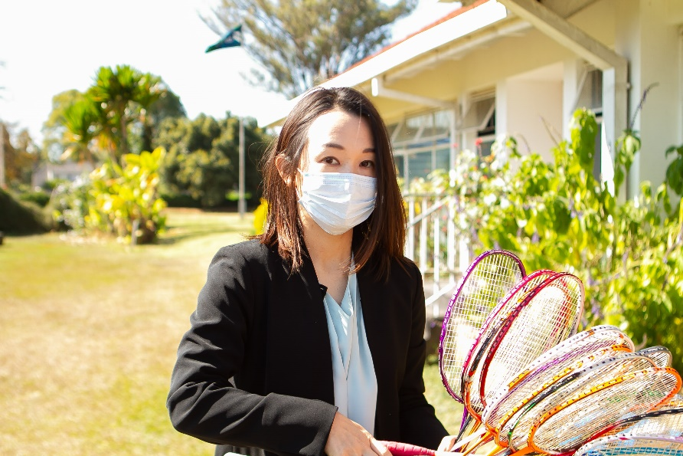
Notes:
Links:
https://www.pexels.com/photo/photo-of-people-doing-handshakes-3183197/
https://www.pexels.com/photo/photo-of-people-holding-each-other-s-hands-3184436/

Slide 31
Equipment
Equipment donation by the NIPPON Badminton Association
Equipment donation from Badminton Confederation Africa

Slide 32
Sponsorship opportunities

Slide 33
Sponsorship – what we offer
Visibility
Participation
Brand image
Corporate Social
Responsibility
Widespread visibility in a variety of ways – events, activities, conferences etc
Gives opportunities for sponsor’s personnel to take part as well, their families, sponsor’s community while advancing the same across the country
Opportunities to elevate sponsor’s image and demonstrate to sponsor’s stakeholders that they are socially engaged and interested in supporting worthwhile projects
Providing value to the community and giving back to the youth, environment and opportunities to align with MDGs

Slide 34
Contact Us
We are happy to engage and discuss further sponsorship opportunities highlighted. Kindly contact us on:
Email: zimbabwebaassociation@gmail.com
Phone: +263 772 339 854, +263 772 257 342,
+263 78 002 8677 (all WhatsApp also)
Website: http://zimbadminton.org.zw/

Slide 35
THANK YOU

